Slide 1
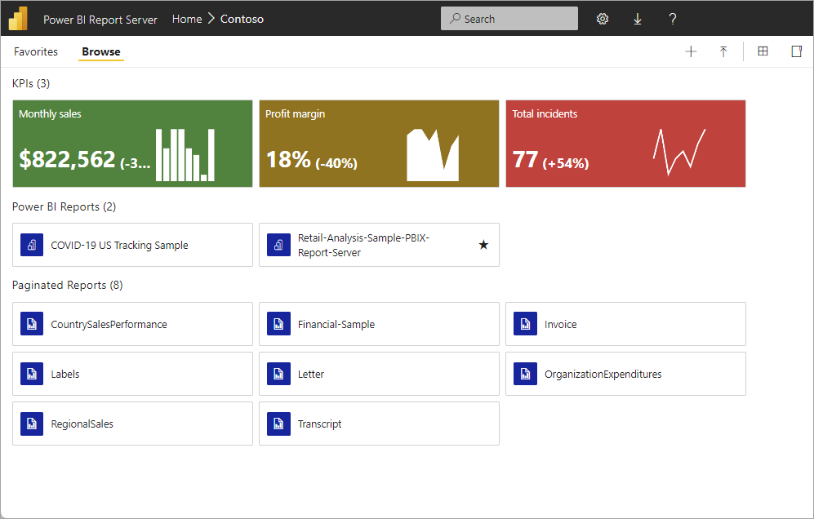
Power BI Report Server

Slide 2
What is Power BI Report Server

Slide 3

Power BI Report Server is an on-premises report server with a web portal in which you display and manage reports and KPIs.
Along with it come the tools to create Power BI reports, paginated reports, mobile reports, and KPIs.
Your users can access those reports in different ways: viewing them in a web browser or mobile device, or as an email in their in-box.

Slide 4
Comparing Power BI Report Server
Power BI Report Server is like both SQL Server Reporting Services and the Power BI online service, but in different ways.
Like the Power BI service, Power BI Report Server hosts Power BI reports (.pbix), Excel files, and paginated reports (.rdl).
Like Reporting Services, Power BI Report Server is on premises.
Power BI Report Server features are a superset of Reporting Services.
Everything you can do in Reporting Services, you can do with Power BI Report Server, along with support for Power BI reports.

Slide 5
Features | Power BI Report Server | Power BI Service | Notes
Analyze in Excel | No | Yes | Analyze in Excel
Bookmarks | No | Yes | Bookmarks in the Power BI service
Composite models | No | Yes
Create Power BI reports in the browser | No | Yes
Dashboards | No | Yes | Dashboards in the Power BI service
Distribute group of reports using apps | No | Yes | Create and publish apps with dashboards and reports
Dynamic M Query Parameters | No | Yes
Export to Power Point (PPTX) | No | Yes | Export data for visuals to CSV or Excel options are available in Report Server.
Gateway required | No | Yes for on-premises data sources
Host and connect to Power BI shared datasets | No | Yes | Intro to datasets across workspaces
Q&A | No | Yes | Q&A in the Power BI service and Power BI Desktop
Quick insights | No | Yes | Automatically generate data insights with Power BI
Personalize visuals | No | No | You can interact with a report to see different data, but you can't modify the report itself.
Real-time streaming | No | Yes | Real-time streaming in Power BI
Automatic page refresh for DirectQuery models | No | Yes | Automatic page refresh
Email subscriptions for Power BI reports | No | Yes | Subscribe yourself or others to a report or dashboard in the Power BI service
Data alerts | No | Yes | Data alerts in the Power BI service
Many-to-many relationships | No | Yes | Apply many-to-many relationships in Power BI Desktop
Cross-report drillthrough | No | Yes | Use cross-report drillthrough
R scripts and visuals | No | Yes | Create R visuals and run R scripts in Power BI Desktop and publish them to the Power BI service. You can't save Power BI reports with R scripts or visuals to Power BI Report Server.
Python scripts and visuals | No | Yes | Create Python scripts and visuals in Power BI Desktop and publish them to the Power BI service. You can't save Power BI reports with Python scripts or visuals to Power BI Report Server.
Preview features | No | Yes
Data Privacy Levels | No | Yes | Data Privacy Levels are available for reports in the Power BI service. In Power BI Report Server, use Role definitions.
Sensitivity Labels | No | Yes | Sensitivity Labels
Template apps | No | Yes | Install and distribute template apps in your organization

Slide 6
Considerations and limitations
Export data – Data with current layout option for all visuals, including the improvements to the Export to Excel experience for Power BI table and matrix visuals.
Only the Summarized data option is supported within Power BI Report Server. The key influencers visual.

Slide 7
Install Power BI Report Server

Slide 8

On-premises reporting with Power BI Report Server
Press Shift + F5
And then click on icon

Slide 9
Install your report server

Slide 10
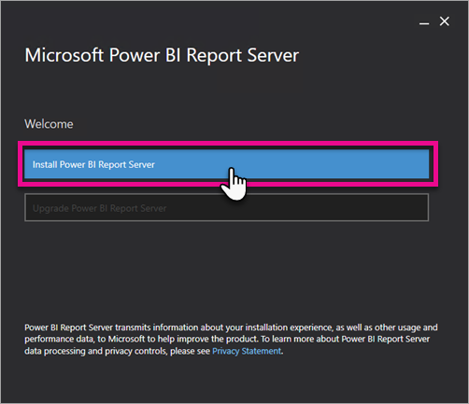
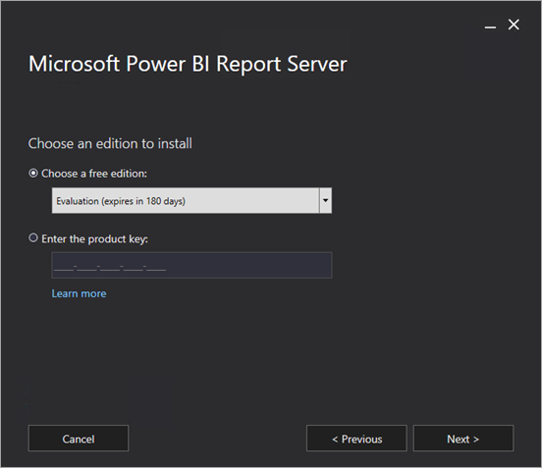

Slide 11
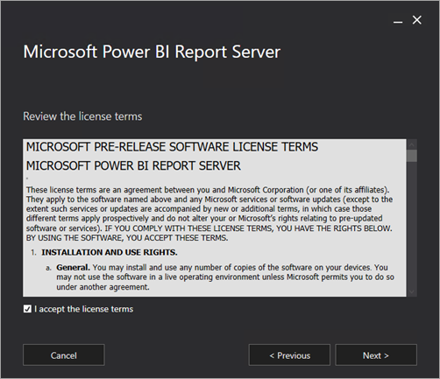
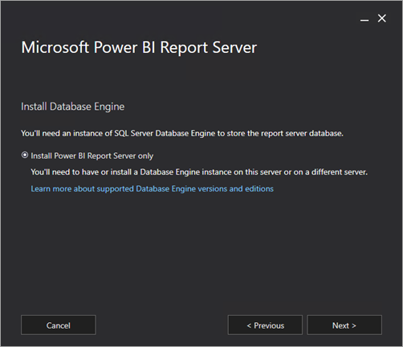

Slide 12
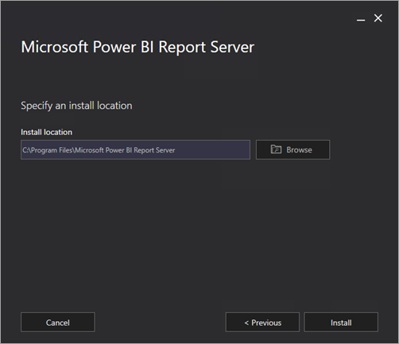
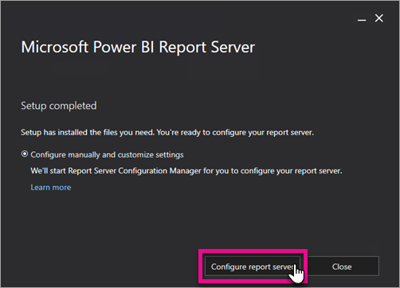

Slide 13
Report Server Configuration

Slide 14
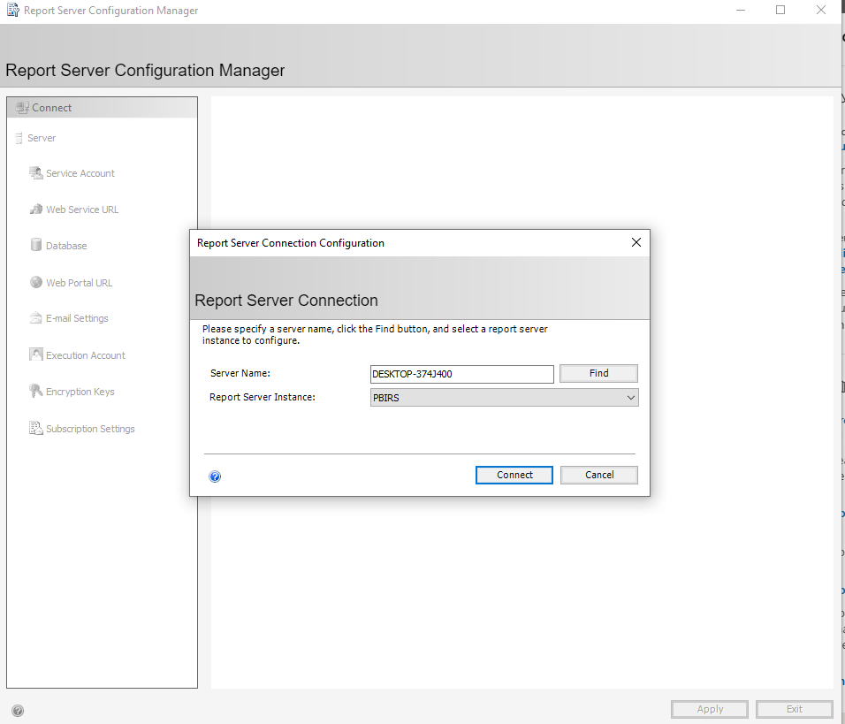
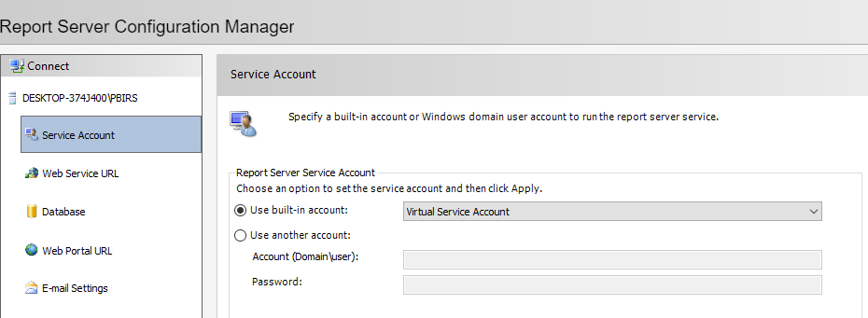
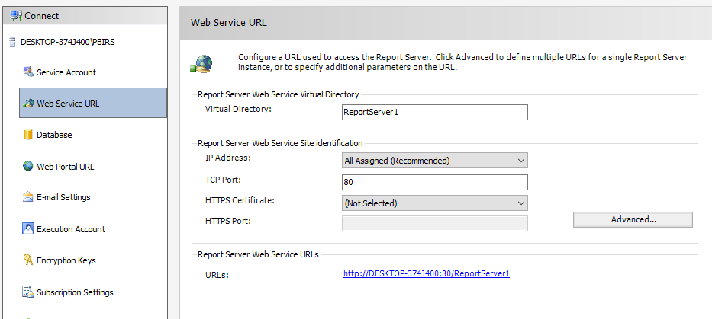

Slide 15
